Slide 1

Summarizing data

Slide 2
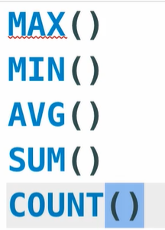
Aggregate Functions
Aggregation function called aggregate function because they take a series of values and aggregate them to produce signal value
MYSQL Build in Aggregations functions:

Slide 3
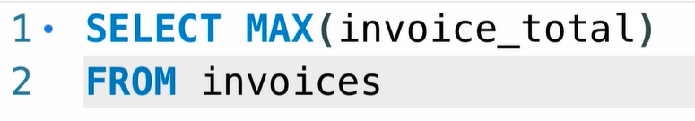
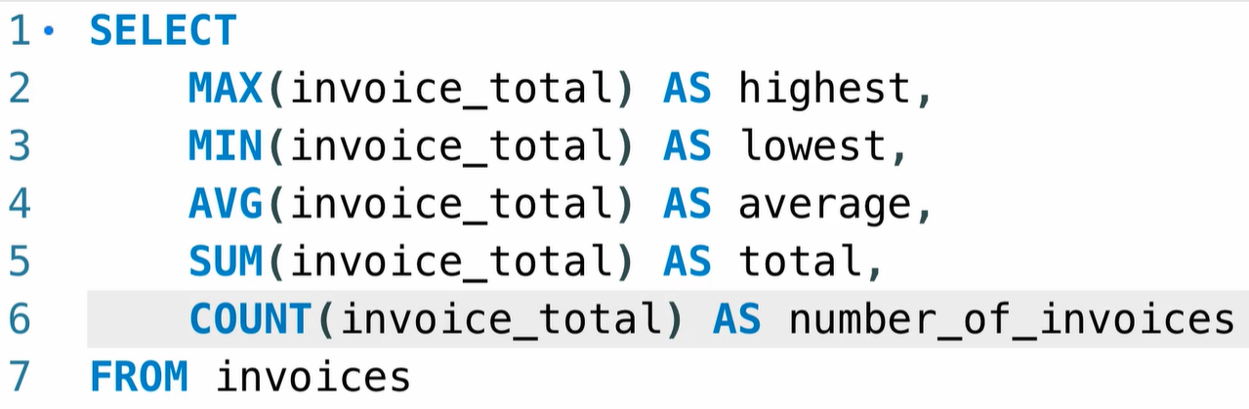
Aggregation function examples

Slide 4
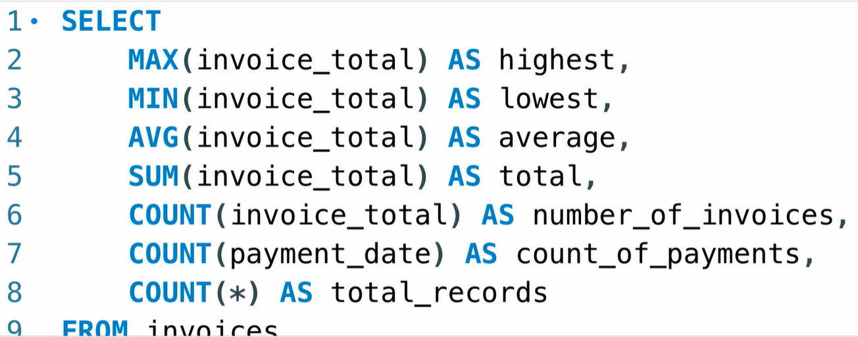
* Count null

Slide 5
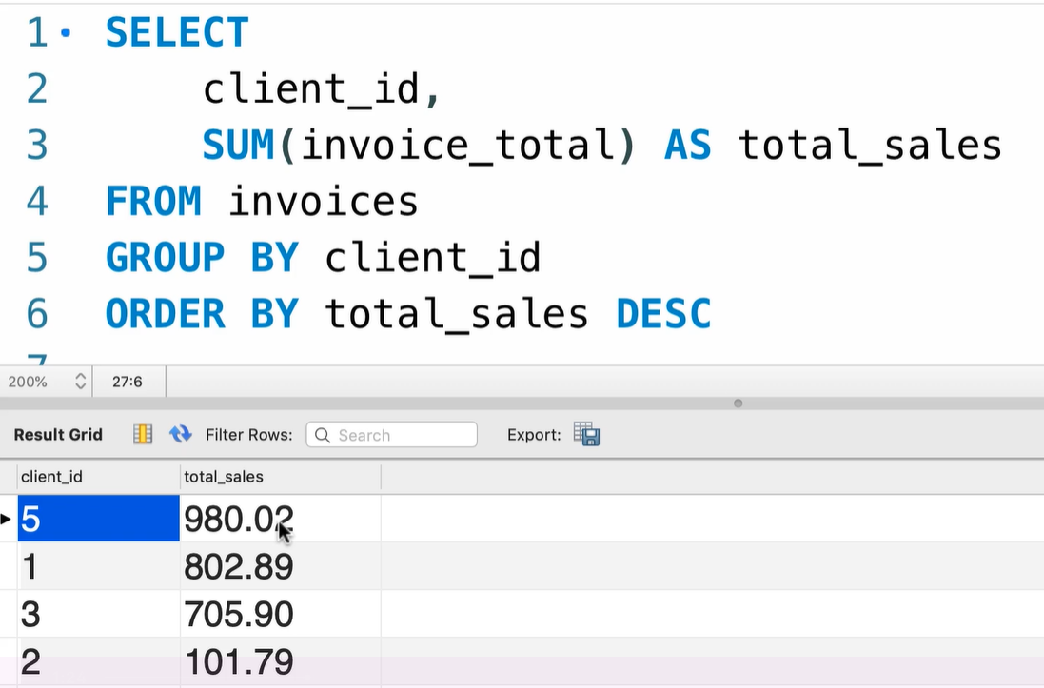
Group by
Group data by one or more columns

Slide 6
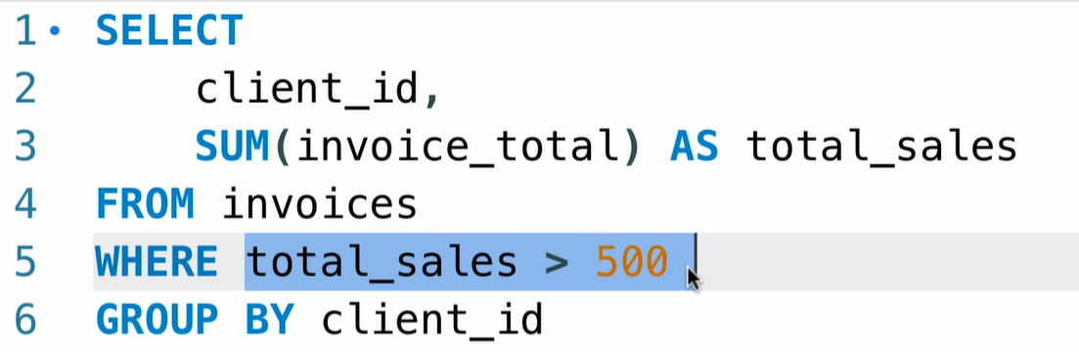
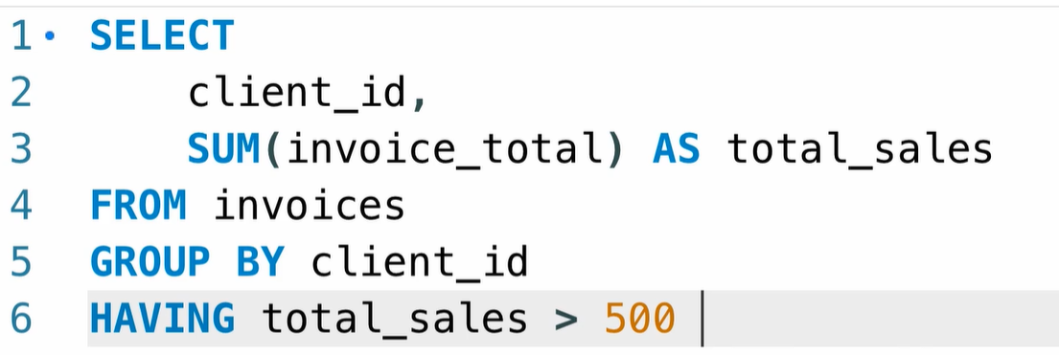
Having Clause
Include just clients with total sales more then 500. if u run the script below u will receive error unknown column name

Slide 7
Exercise
Get the customers located in Virginia who have spent more than 100$

Slide 8
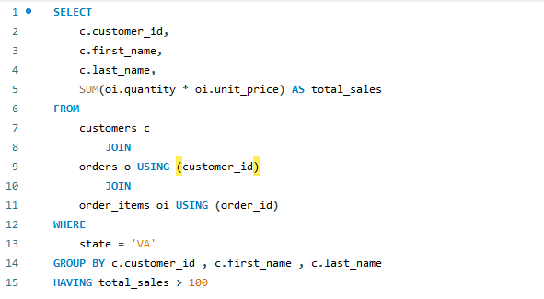
Solution

